Slide 1
LIVE STORY SD-2: Life in Weeks Timeline Hackathon Project Presentation
Presented By:
1.Anurag Sharma
2.Sagnik Dey
3.Sushmitha S

Slide 2
Introduction
SD-2: Life in Weeks Timeline is a full-stack interactive app that visualizes every week of a user's life with personal and historical events ( seeded using Kaggle data set) It helps users reflect on their life, recognize patterns, and commemorate important milestones.

Slide 3
Why This Project Matters
Helps visualize life holistically
Offers a visually structured and meaningful representation of your timeline

Slide 4
Core Features
- timeline Grid(since birth): Interactive overview of every week since the users' birth into a visually appealing story line
- Event Management: Add, edit, delete personal milestones ( using prostgre SQL drizzle ORM )
- Responsive UI/UX using in tailwind CSS & ShadCN UI
- Timeline filters by category
Exports timeline in pdf format showcasing all the events ( categorially ) since the birth

Slide 5
Tech Stack
Frontend: Next.js, Tailwind CSS
Backend: Next.js API routes, drizzle ORM
Database: PostgreSQL (Neon DB)
Authentication: Clerk.js
Deployment: Vercel

Slide 6
Architecture & Flow
1. User signs up → intuitive onboarding form containing birthday, bio, basic personal details & profile image
2. Timeline engine fetch's data from DB & generates week by week updates
3. added using next.js API routs & drizzle
4. Timeline updates dynamically with overlays

Slide 7
Challenges & Solutions
- Historical data load → Caching & debounce strategies
Api fetching is limited & restricted ( due to limited free trier ) → downloaded Kaggle data set of historical events ( cleaned the uncensored & unknow data ) & seeded data from CSB using papaparse which will seeded to DB tailored to users MAIL ( 1 time )

Slide 8
Impact & Use Cases
- Life reflection & memory preservation
- Therapy, journaling, and self-awareness
- Family legacy creation
- Education updates, storytelling, major life milestones

Slide 9
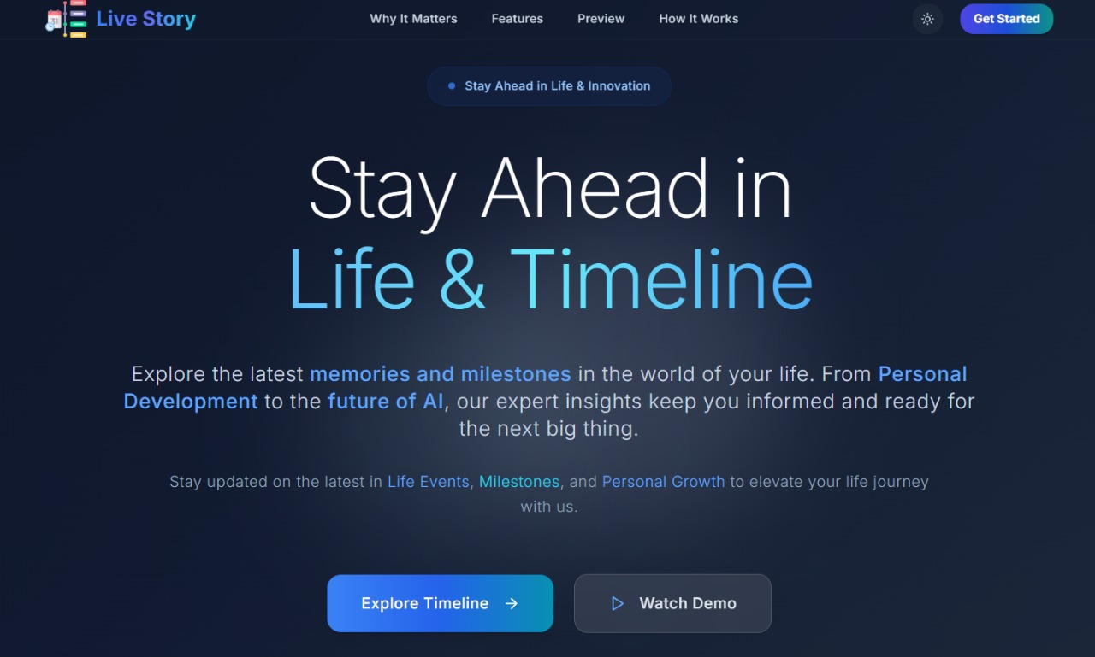

Slide 10
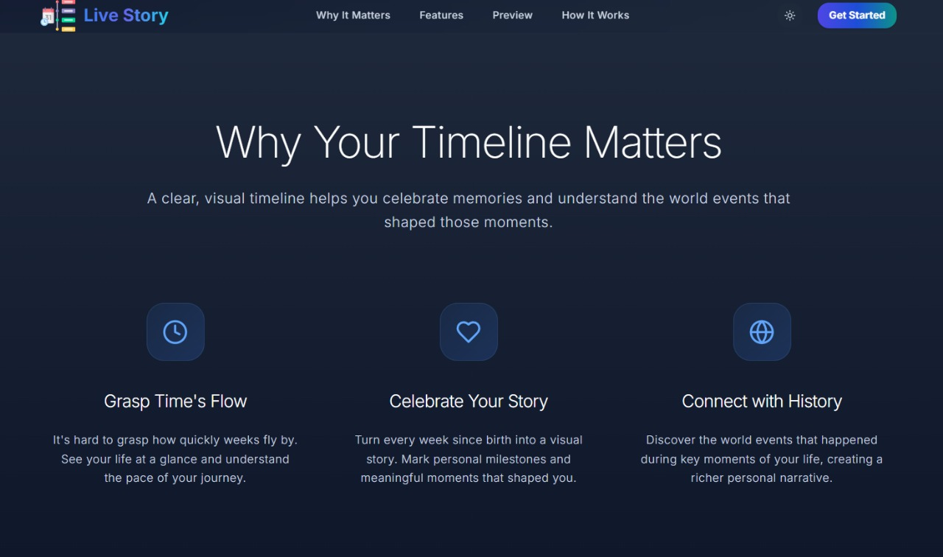

Slide 11
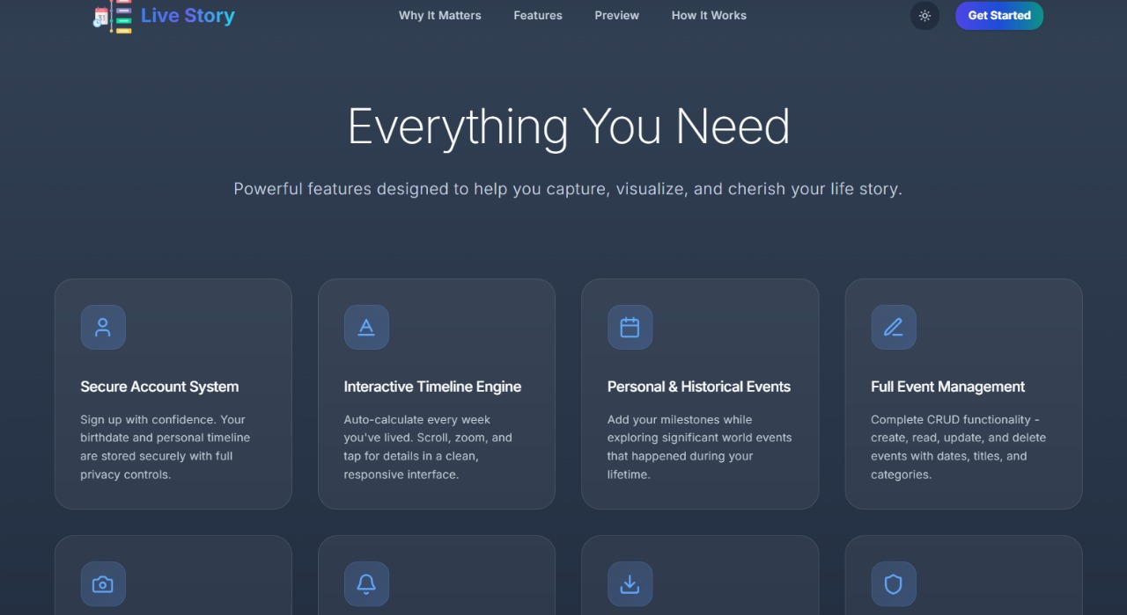

Slide 12
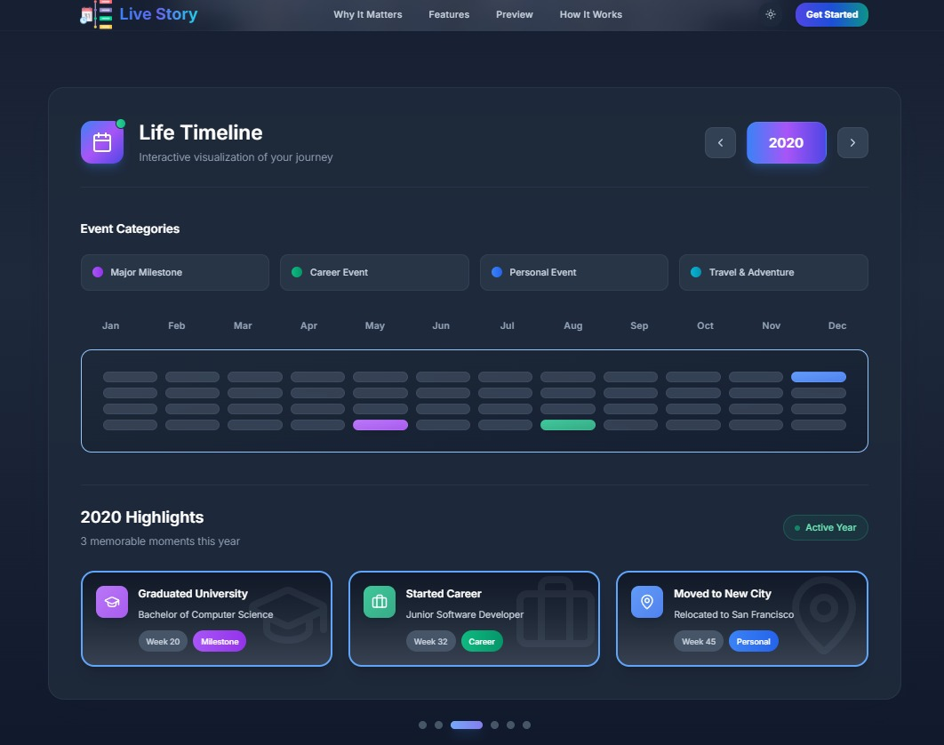

Slide 13
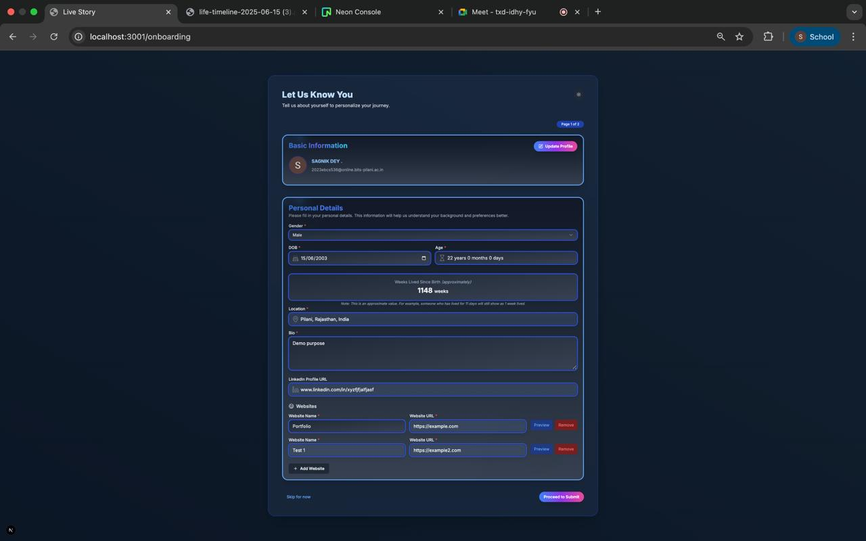
ON BORDING FORM

Slide 14
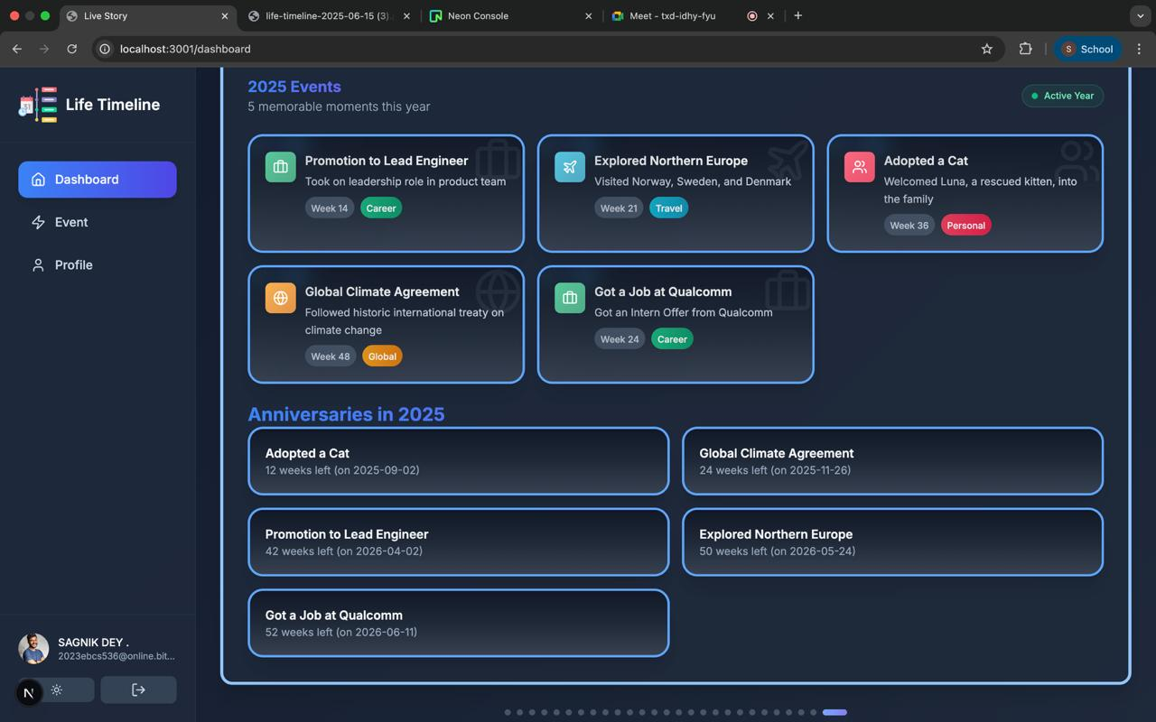
DASHBORD

Slide 15
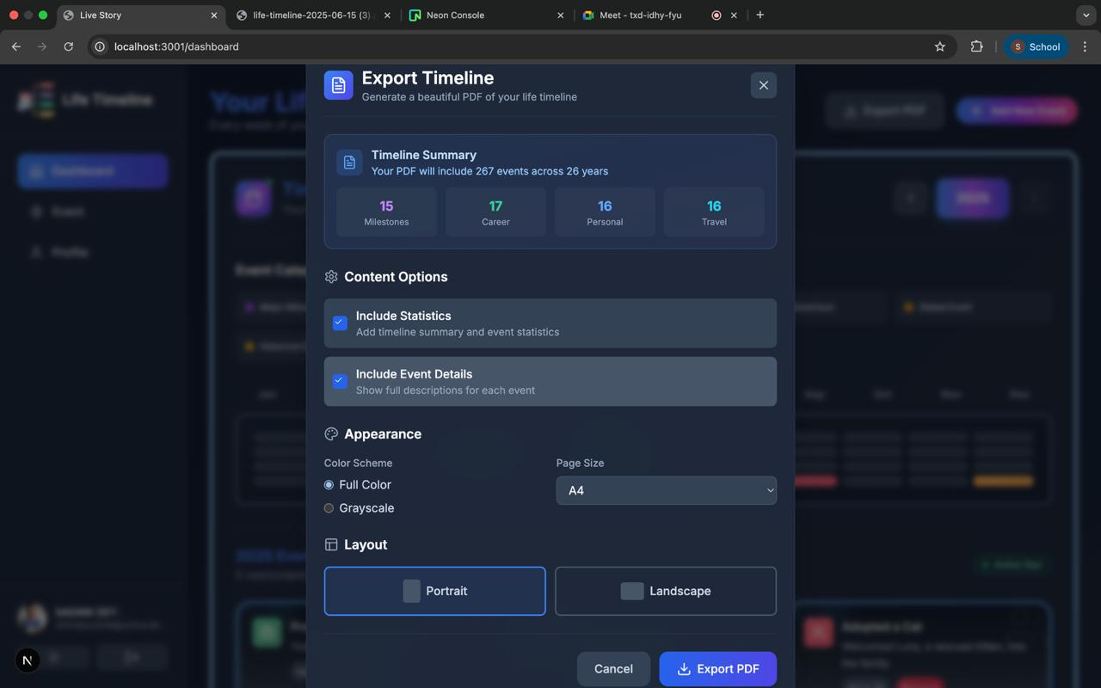
EXPORT YOUR MEMORIES INTO PDF

Slide 16
Deliverables
GitHub Repository with detailed README
Fully deployed on Vercel app
8 minute presentation video
Submission form with all required links
Submitted the ppt

Slide 17
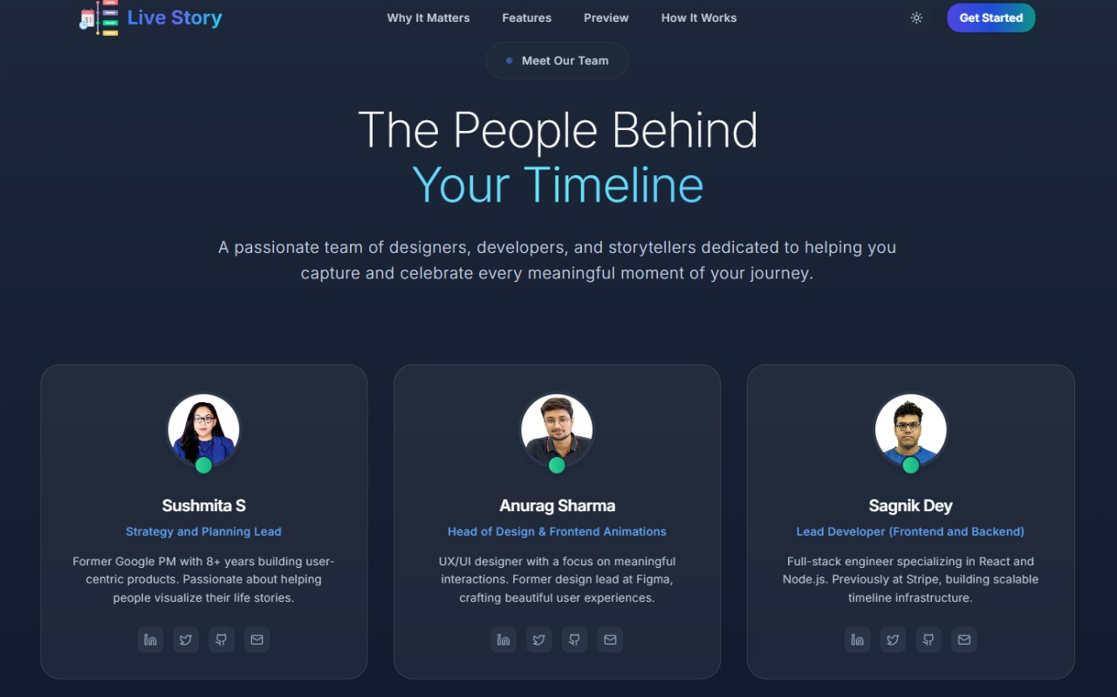

Slide 18
DISCLAIMERS :
We have taken guidance from these AI platforms
Gemini, ChatGPT, Claude, Loveable.dev, bolt.new, Llama 3.3
They have had a huge impact in helping us achieve this feat.
Hope you can enjoy & cherish memories & milestones by using LIVE STORY.

Slide 19
Thank You!
We’re excited to hear your feedback!

